Slide 1
Signals and Systems
Lecturer:
Dr. Bin Xia
Dept. of Electronic Engineering
Shanghai Jiao Tong University
Chapter 1: Introduction

Slide 2

Staff
Lecturer:
  Bin XIA （夏斌）
    Office: R301A, No.5, SEIEE Bld.
    Tel: 3420-7494
    Mobile: 137-6138-1159
    Wechat： smileshah
    Email: bxia@sjtu.edu.cn
    http://iwct.sjtu.edu.cn/Personal/bxia/
TA
  TBD
    Office: R309, No.5, SEIEE Bld.
    Mobile: ?
    Email: ?

Slide 3
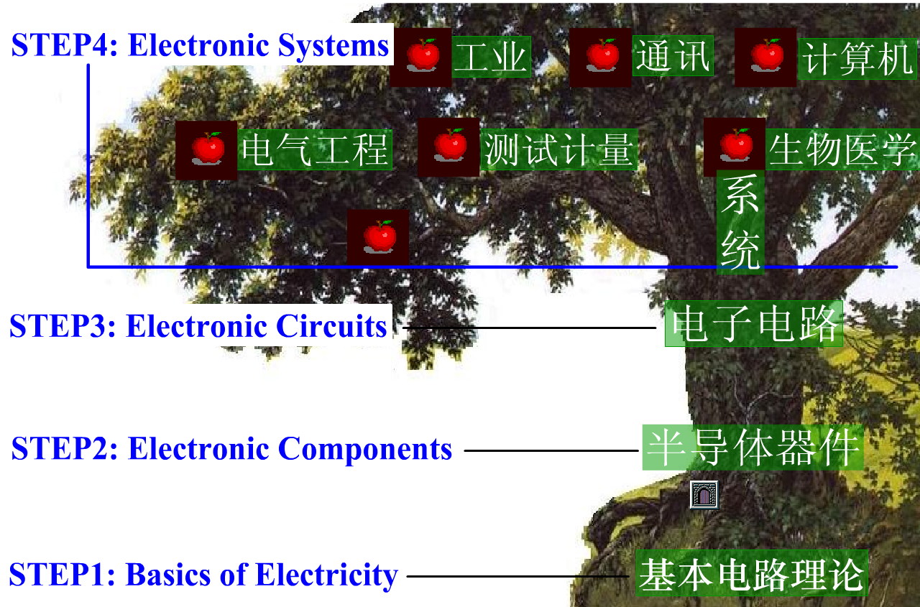
Objective
A fundamental course providing essential knowledge for engineering related areas
Engineering Systems
Engineering Courses
信息论、通信原理、数字信号处理。。。
Fundamental Engineering Courses
信号与系统
Fundamental Courses
数学，物理

Slide 4
Objective
Why
  Robot
  Hunting
What: To investigate the fundamental concepts, theories and methodologies for
  Characterization of the signal and systems using widely-accepted engineering terminology
  Design and synthesis of signals and systems with particular properties and purposes using time domain and transform domain approaches
Goal: To develop students abilities to
  Apply knowledge of mathematics for engineering
  Design a system, component or process to meet desired needs
  Identify, formulate and solve engineering problems
  Design and conduct simulations and experiments

Slide 5
About the teaching method
In class
  Attention will be paid to the principles and fundamentals
    e.g. physical operation and electric characteristics of diodes and transistors will be explained in detail by adding some basic knowledge of semiconductors
  Emphasis will be mainly focused on qualitative analysis and consequently,
  What is taught may be different from the textbook both in content and order

Slide 6
About the teaching method
Outside class
  Self-study before and after the class is required for better understanding of what you are learning
  Exercises are another way to strengthen your quantitative analysis ability
Additional benefit: intensive reading may also greatly improve both your essential and professional English ability

Slide 7
About Q&A
No settled schedule for Q&A. It may be arranged for the final examination if needed.
You are welcome for any questions before and after the class. You can also contact us via e-mail, WeChat and telephone.

Slide 8
Assessment
Homework: 40%
  5 sets of homework
  4-level grading (A, B,C,D) for each homework
Mid-term Test: 10%
  In-class open-book test (for special case, if absence of the test, it will be the same as the score of Homework)
Final Exam: 50%

Slide 9
Others
Class Requirements
  Attendance record >75%
  Actively participate in discussions and inter-actions
  NO disturbing with others
Lecture Notes available at ftp://public.sjtu.edu.cn
  Username: bxia
  Password: public
  Available ONE week after the class

Slide 10
References
Textbook
Signals & Systems (Second Edition)
by Alan V. Oppenheim, 电子工业出版社
References
  《信号与系统》刘树棠，西安交通大学出版社
  《复变函数》严镇军，中国科学技术大学出版社
  《信号与系统》（上、下）郑君理，高等教育出版社
  《信号与系统 理论、方法和应用》徐守时等，中国科学技术大学出版社

Slide 11
Syllabus
Ch01: Introduction (2 weeks _4 classes)
Ch02: Linear Time-Invariant Systems (2.5 weeks _6 classes)
Ch03: Fourier Series Representation of Periodic Signals (1.5 weeks _3 classes)
Ch04: Continuous-time Fourier Transform (2.5 weeks _6 classes)
Ch05: Discrete-time Fourier Transform (1 week _2 classes)
Ch06: Laplace Transform (2.5 week _6 classes)
Ch07: z Transform (2 week _4 classes)
Notes:
2：离散时间信号与系统 和 连续时间信号与系统
2：时间域分析方法 和 变换域分析方法
2：LTI系统 和 LCCDE描述的系统
1个联系离散与连续时间信号与系统的纽带

Slide 12
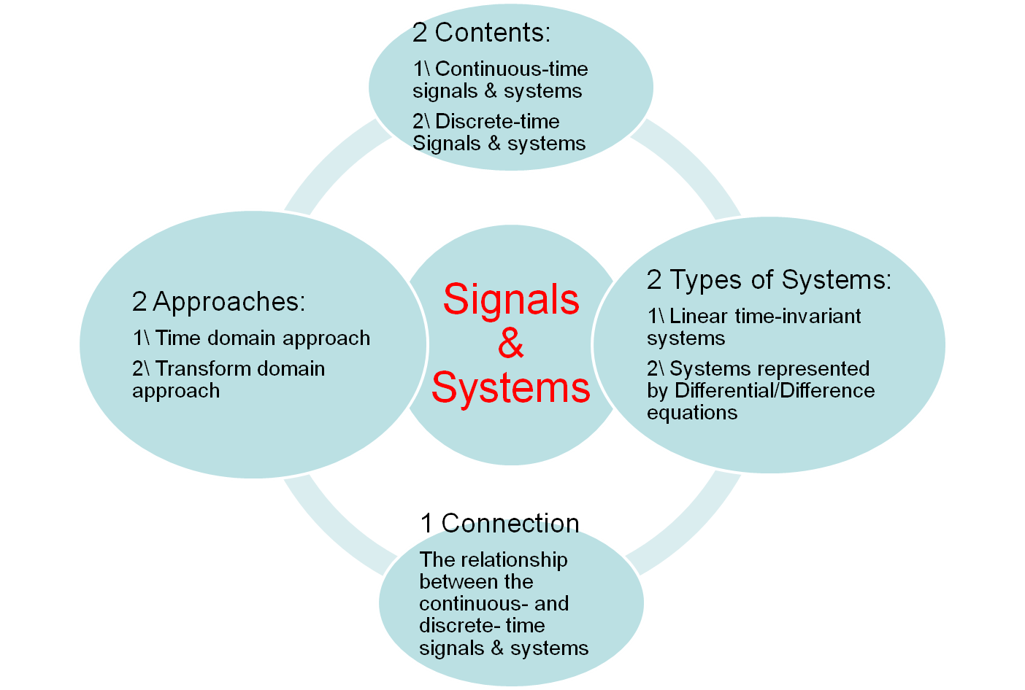
Course Structure
W1.1

Slide 13
Foreword of the Chapter
Signals
  Definitions, representations and classifications
  Fundamental signal transformations
  Typical signal examples
Systems
  Concepts, representations, and classifications
  Basic properties of systems

Slide 14
Outline of the Chapter
1.1 Definitions and Representations of Signals
1.2 Transformations of Independent Variable
1.3 Classifications of Signals
1.4 Typical Signals
1.5 Definitions and Representations of Systems
1.6 Properties of Systems
1.7 System Interconnections

Slide 15
1.1.1 Definitions
  Information: physical nature and behavior of some phenomenon; a collection of related data or knowledge about a topic
  Signal: mathematic representation of a signal is a function of independent variables that carry information
    Electrical signals ---voltages and currents in a circuit
    Acoustic signals ---audio or speech signals (analog or digital)
    Video signals ---intensity variations in an image (e.g. a CT scan)
    Biological signals ---sequence of bases in a gene

Slide 16
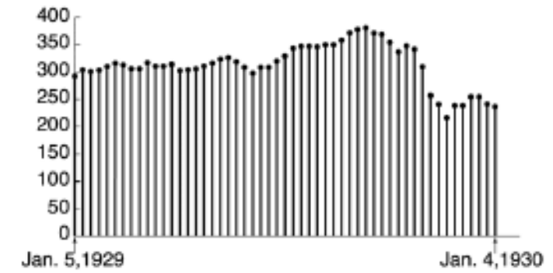

1.1.2 Independent Variables can be
  Continuous
    Voltage/current
    Vehicle speed
  Discrete
    DNA base sequence
    Weekly average for stock markets
  1-D, 2-D, ••• N-D
    2-D/3-D Digital image pixels
In this course, we focus on a single (1-D) independent variable which we call“time”

Slide 17

1.2.3 Continuous-Time (CT) vs. Discrete-Time (DT) Signals:
  Continuous-Time (CT) Signals: x(t)
    Independent variable (t) is continuous
    The signal is defined for a continuum of values of the independent variable (t)
x(t)
t

Slide 18
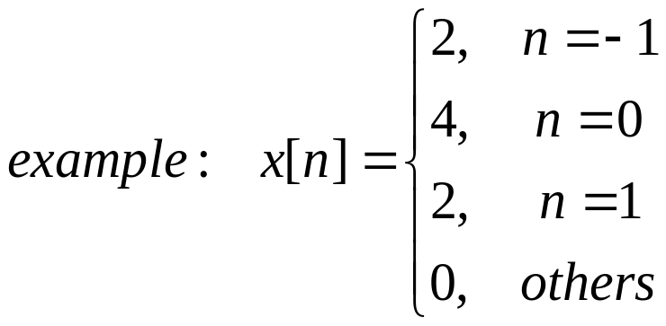
  Discrete-Time (DT) Signals/Sequences: x[n]
    Independent variable (n) takes on only a discrete set of values, in this course, a set of integer values only
    Signal is defined only at discrete times
x[n]
n

Slide 19
  In general, we use
    the symbol t to denote the continuous-time independent variable and n to denote the discrete-time independent variable,
    Enclose the independent variable in parentheses () for continuous-time signals, i.e. x(t), and brackets [] for discrete-time signals, i.e. x[n]

Slide 20
Outline of the Chapter
1.1 Definitions and Representations of Signals
1.2 Transformations of Independent Variable
1.3 Classifications of Signals
1.4 Typical Signals
1.5 Definitions and Representations of Systems
1.6 Properties of Systems
1.7 System Interconnections

Slide 21
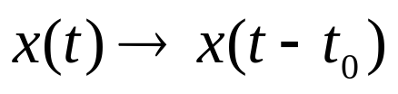

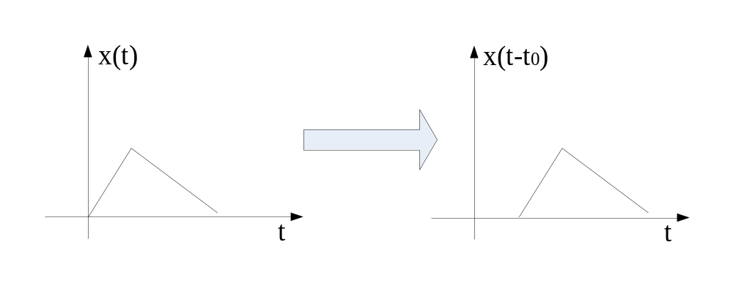
1.2.1 Time Shift
E.g ：Radar, Sonar, Radio propagations
Notes: Each point in x(t)/x[n] occurs at a later/early time in x(t-t₀)/x[n-n₀], when t₀/n₀ is positive/negative, i.e.
x(t-t₀)/x[n-n₀] is the delayed version of x(t)/x[n], for t₀/n₀ >0
x(t-t₀)/x[n-n₀] is the advanced version of x(t)/x[n], for t₀/n₀ <0

Slide 22


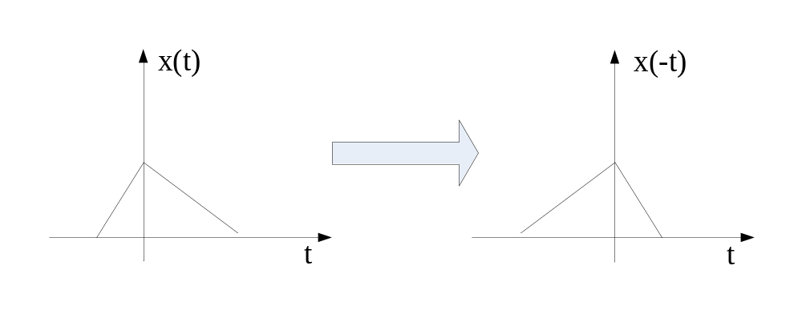
1.2.2 Time Reversal
E.g.：tape recording played backward

Slide 23


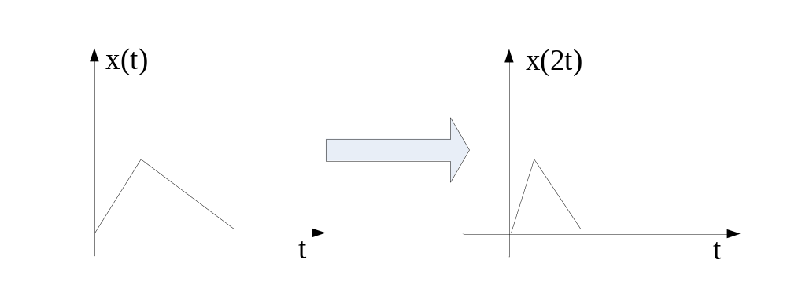

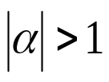


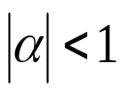

1.2.3 Time Scaling
For DT signal: Decimator, Interpolator
E.g. ：tape recording played:
fast forward
slow forward
slow backward
fast backward
Notes：
—Compression
—Extension

Slide 24


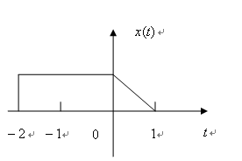

1.2.4 A General Transform of the Independent Variable
Example 1.1:
Rule:
time shift first
then reflection(time reversal) and time scaling

Slide 25
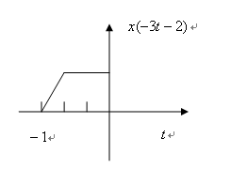
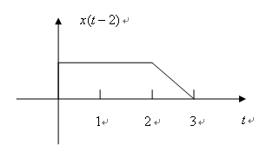
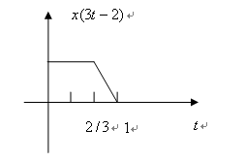
Question: what happens if shifting after scaling/reflection
x(-3(t+2/3))

Slide 26
Outline of the Chapter
1.1 Definitions and Representations of Signals
1.2 Transformations of Independent Variable
1.3 Classifications of Signals
1.4 Typical Signals
1.5 Definitions and Representations of Systems
1.6 Properties of Systems
1.7 System Interconnections

Slide 27
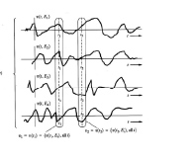
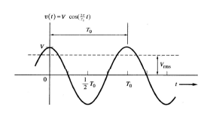
1.3.1 Deterministic vs. Random Signals
  Deterministic Signals: could be represented by analytical expressions/functions for all times
  Random Signals: cannot find a function to represent it
Example of Deterministic Signals
Example of Random Signals

Slide 28

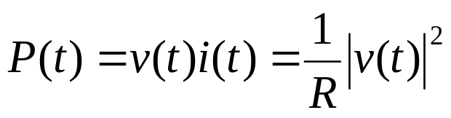
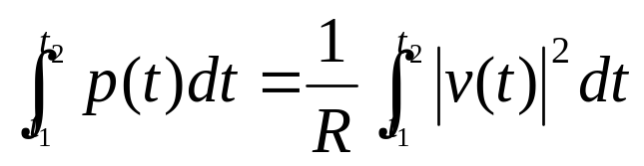
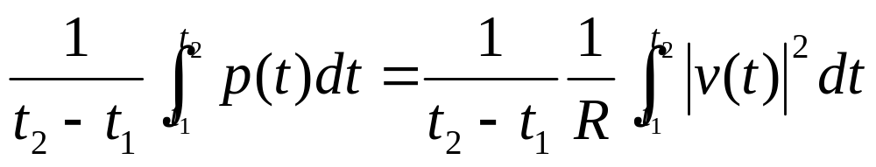
1.3.2 Finite-energy vs. Finite-power Signals
Modular operation
Instantaneous power
Total energy over time interval [t₁, t₂]
Average power over time interval [t₁, t₂]

Slide 29
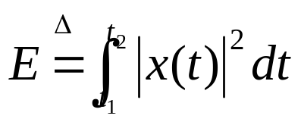
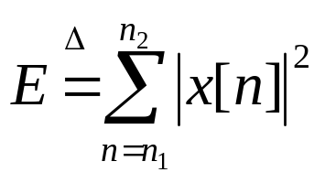
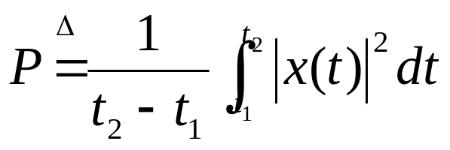
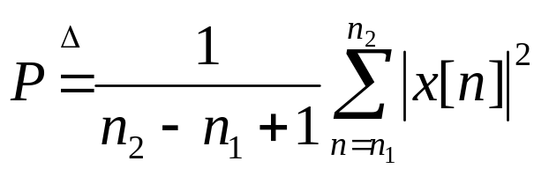
  Power and energy definitions in the course
Total energy
Average power
Energy and power definitions over infinite interval?

Slide 30
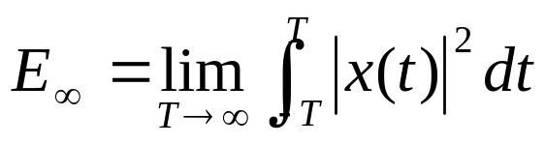
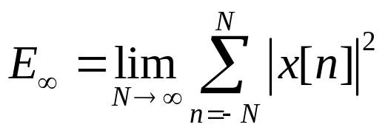
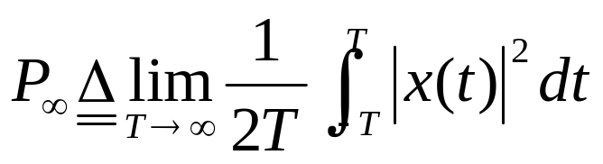
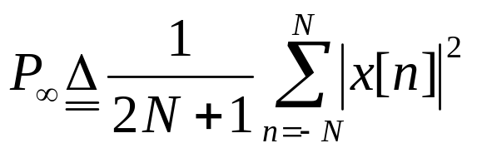
  Power and energy definitions over an infinite interval
Total energy
Average power

Slide 31
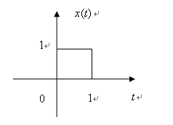




Finite-energy signal(能量有限信号)
e.g.：
Finite-power signal(功率有限信号 )
e.g.：x[n]=4
Infinite-power and energy signal
e.g.：x(t)=t

Slide 32






1.3.3 Periodic and Aperiodic Signals
  Definition：
  if
  for all values of , is periodic
  Then for all and any integral
  Fundamental Period: the smallest positive value of satisfying for all
If the signal is constant,
the fundamental period is undefined
W1.2

Slide 33





For discrete-time signals
  Definitions：
  if
  for all values of , is periodic
  Then for all and any integral
  Fundamental Period: the smallest positive value of satisfying for all
If the signal is constant,
the fundamental period ?

Slide 34
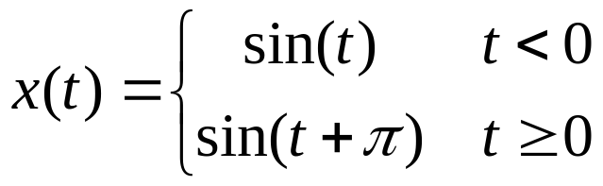
Example 1.2:
Draw the signal
To verify if the signal is periodic or aperiodic?
If it is periodic, what’s its fundamental period of the signal?

Slide 35










Example 1.3:
Calculate the fundamental period of signals
the fundamental period of is 1/5
the fundamental period of is 1/2
the fundamental period of is the least common multiple of and , i.e. 1
the fundamental period of is 1, not 1/2
is apriodic,
so is apriodic

Slide 36





1.3.4 Even and Odd Signals
  Definitions
  or is even if it is identical to its time-reversed counterpart
  Similarly, or is odd if
For odd signal , can one determine ?

Slide 37

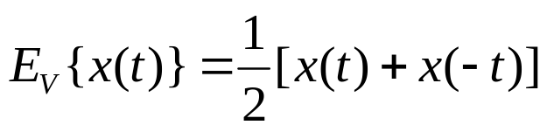
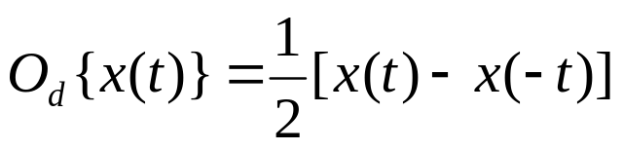
Even-odd decomposition of a signal
Even part
Odd part

Slide 38
Outline of the Chapter
1.1 Definitions and Representations of Signals
1.2 Transformations of Independent Variable
1.3 Classifications of Signals
1.4 Typical Signals
1.5 Definitions and Representations of Systems
1.6 Properties of Systems
1.7 System Interconnections

Slide 39
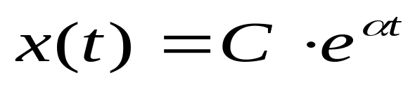

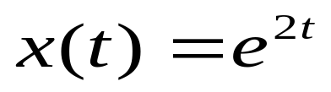



1.4.1 Continuous-Time Complex Exponentials Signals and Sinusoidal Signals
  where are complex numbers
  Real Exponential Signals: when are real numbers, e.g.
growing exponential, when
decaying exponential, when
constant

Slide 40



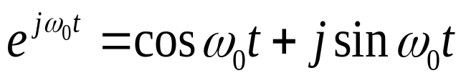
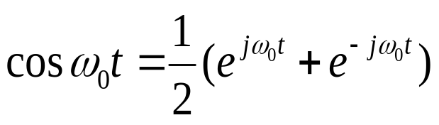
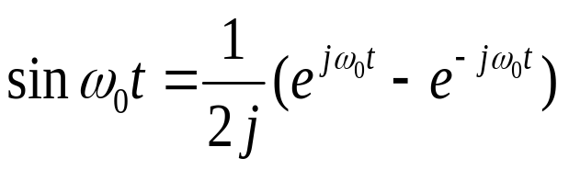



  Periodic Complex Exponential and Sinusoidal Signals: when is real, is purely imaginary, e.g.
  then the fundamental period T₀=2π/ ω₀ [s] , angular frequency ω₀ [rad/s], and frequency f₀=ω₀/2π=1/T₀ [Hz]
  Unless noted otherwise, in this course, we always call ω₀ frequency
  Euler’s Relation,
  Important periodicity property :
  1) the larger the magnitude of , the higher the oscillation in the signal
  2) the signal is periodic for any value of

Slide 41
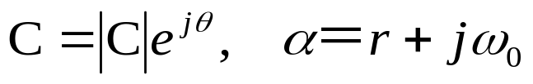
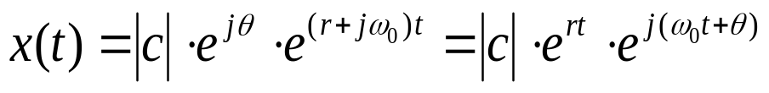
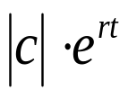


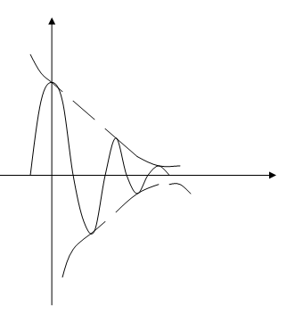

  A general representation, when are complex numbers, denoted as ,then
is the envelop of the waveform:
is the oscillation frequency
Example of real part of :
Damped sinusoids
W2.1

Slide 42
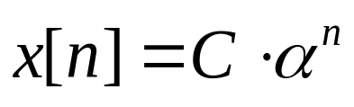
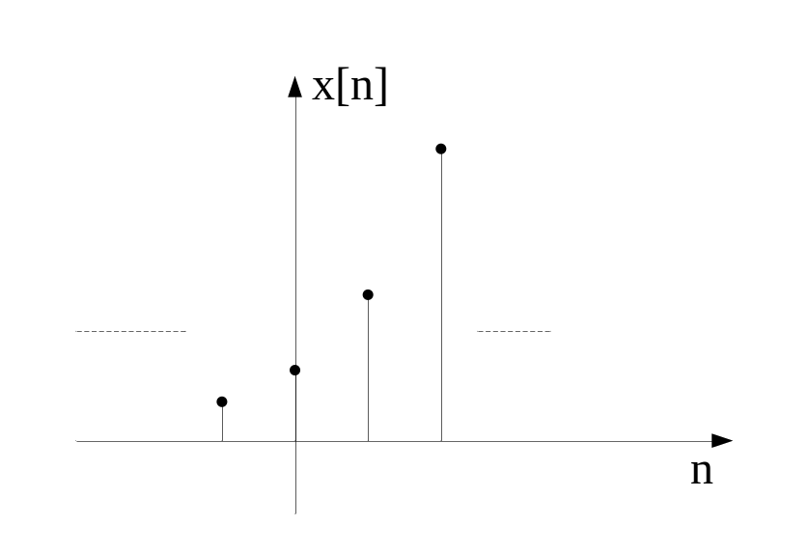
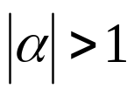

1.4.2 Discrete-Time Complex Exponentials Signals and Sinusoidal Signals
  where are complex numbers
  Real Exponential Signals: when are real numbers, e.g.
    growing function, when

Slide 43
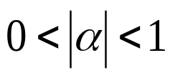
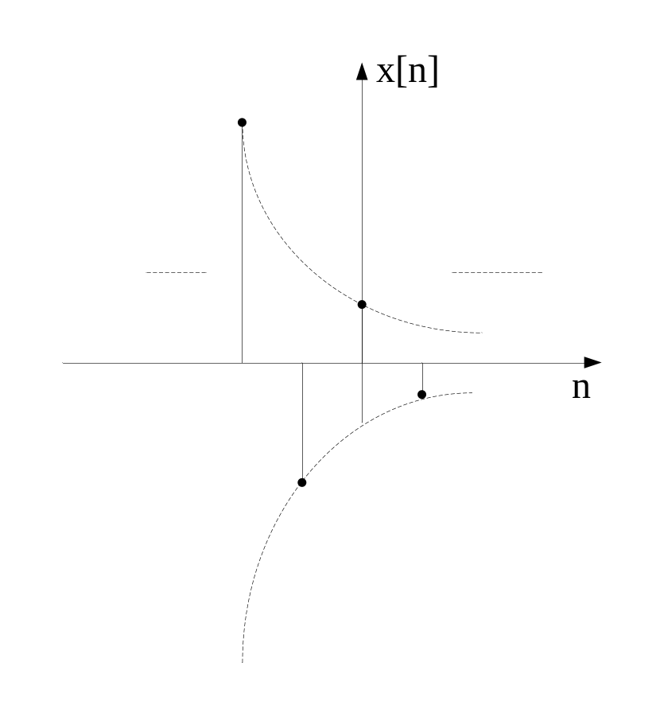
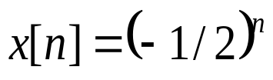



    decaying function, when
    constant, when
    alternates in set , when

Slide 44
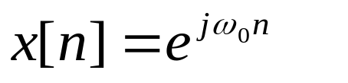

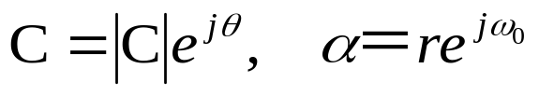
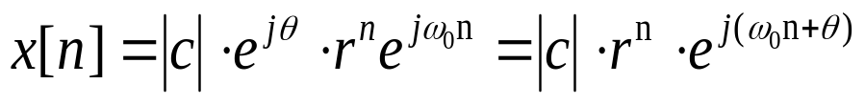
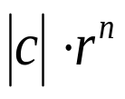
  Complex Exponential and Sinusoidal Signals: when is real, is a point on the unit circle, e.g.
  or
Its periodicity property? Similar to that of continuous-time signals?
  A general representation, when are complex numbers, denoted as ,then
is the envelop of the waveform:

Slide 45







Periodicity Property of Discrete-time Complex Exponentials
a) recall the definition of the periodic discrete-time signal
for all
b) if it is periodic, there exists a positive integer , which satisfies
so, it requires , i.e.
c) If there exists an integer satisfying that is an integer, i.e. is rational number , is periodic with fundamental period of , where are integers without any factors in common.
otherwise, is aperiodic.
Different from that of continuous exponentials

Slide 46





Example 1.4
1.
if m and N have no common factor, the period is N, if m and N have common factor k, then the period is N/k
since 4 and 31 has no common factor, the period N is 31.
3.
since is irrational, is aperiodic

Slide 47







Another difference from that of CT exponentials
since for any integer
the signal is fully defined within a frequency interval of length : ,for any integer
Distinctive signals for different ω₀ within any 2π region, i.e.
, for any integer m
Without loss of generalization, for , the rate of oscillation in the signal increases with increases from 0 to
Important for discrete-time filter design!

Slide 48







Comparison of Periodic Properties of CT and DT Complex Exponentials/ Sinusoids
Distinct signals for distinct value of | Identical signals for values of separated by multiples of
Periodic for any choice of | Periodic only of for some integers and
Fundamental angular frequency | Fundamental angular frequency , if m and N do not have any factors in common
Fundamental period | Fundamental period

Slide 49






1.4.3 Discrete-Time Unit Impulse and Unit Step Sequences
1．Unit Impulse Sequence
2．Unit Step Sequence

Slide 50






3. Relationship
—1st difference
—running sum
4.Sampling Property
5. Signal representation by means of a series of delayed unit samples
W2.2

Slide 51




1.4.4 Continuous-Time Unit Step and Unit Impulse Functions
1. Unit Step Function
1
Notes： is undefined at t=0
0

Slide 52



Can we find counterpart of the unit impulse function in CT domain as that in DT domain ?
Does there exists satisfing the following relationship
—1st difference
—running sum
?
—1st derivative
—running integral

Slide 53











2. Unit Impulse Function
①
Since u(t) is undefined at t=0, formally it is not differentiable,
then define an approximation to the unit step ,which rises from 0 to 1 in a very short interval .
So
and
Notes: the amplitude of the signal at t=0 is infinite, but with unit integral from to , i.e. from to

Slide 54



② Dirac Definition
0
Notes: the amplitude of the signal at t=0 is infinite, but with unit integral from to , i.e. from to
We also call such functions as singularity function or generalized functions, for more information, please refer to mathematic references

Slide 55




3. Relationship
4. Sampling Property
Can we represent x(t) by using a series of unit samples as that for DT signal?
Derivation of sampling property with the definition of …
5. Scaling Property
Notes:
物理含义和理解：单位冲激函数是理想，是对于足够小的脉冲的近似，真实系统中只要脉冲足够细，不管脉冲是什么形状都不会影响系统的输出的。

Slide 56



Example: to derive the 1st derivative of x(t)

Slide 57

Example: to determine the following signals/values

Slide 58
Outline of the Chapter
1.1 Definitions and Representations of Signals
1.2 Transformations of Independent Variable
1.3 Classifications of Signals
1.4 Typical Signals
1.5 Definitions and Representations of Systems
1.6 Properties of Systems
1.7 System Interconnections

Slide 59









System Modeling
  RLC Circuit
  Mechanism System
R
＋
＋
C
－
－

Slide 60

Observations:
  Very different physical systems may be modeled mathematically in very similar ways.
  Very different physical systems may have very similar mathematical descriptions.

Slide 61
Typical Systems and their block illustrations
  Amplifier
  y(t)=cx(t);
  Adder
  y(t)=x₁(t)+x₂(t)
  Multiplier
  y(t) =x₁(t)*x₂(t)
  Differentiator/Difference
  y(t)=dx(t)/dt, y[n]=x[n]-x[n-1]
  Integrator/Accumulator
  …
Notes:
方框表示和含义
Backward difference y[n]=x[n]-x[n-1], y[n]=/delta x[n] 后向差分 (一般是后向差分)
Forwarding difference 前向差分。。。。

Slide 62
Outline of the Chapter
1.1 Definitions and Representations of Signals
1.2 Transformations of Independent Variable
1.3 Classifications of Signals
1.4 Typical Signals
1.5 Definitions and Representations of Systems
1.6 Properties of Systems
1.7 System Interconnections

Slide 63
Why?
  Important practical/physical implications
  They provide us with insight and structure that we can exploit both to analyze and understand systems more deeply.
Memory vs. Memoryless
Invertibility: Invertible vs. noninvertible
Causality: Casual vs. non-Casual
Linearity: Linear vs. non-Linear
Time-invariance: Time-invariant vs. Time-varying
Stability: Stable vs. non-Stable

Slide 64





1.6.1 Systems with and without Memory
  Systems with memory: if the current output of the system is dependent on future and/or past values of the inputs and/or outputs, e.g.:
    Capacitor system::
    Accumulator system:
  Memoryless systems: if the current output of the system is dependent on the input at the same time, e.g.
    Identity system:
——
——

Slide 65
  Examples: to determine the memory property of the following systems:
    Amplifier, adder, multiplier
    Integrator, accumulator, differentiator, time inverse system, time scalar, decimator, interpolator, …
W3.1

Slide 66



1.6.2 Invertibility: Inverse vs. non-inverse systems
  Inverse systems: distinct inputs lead to distinct outputs, e.g.
  Non-inverse systems: distinct inputs may lead to the same outputs, e.g.
  Importance of the concept: encoding for channel coding or lossless compress

Slide 67
1.6.3 Causality: A system is causal if the output does not anticipate future values of the input, i.e., if the output at any time depends only on values of the input up to that time.
  All real-time physical systems are causal, because time only moves forward. Effect occurs after cause. (Imagine if you own a noncausal system whose output depends on tomorrow’s stock price.)
  Causality does not apply to spatially varying signals. (We can move both left and right, up and down.)
  Causality does not apply to systems processing recorded signals, e.g. taped sports games vs. live show.

Slide 68
  Mathematical definition: A system x(t) →y(t) is casual if
when x₁(t) →y₁(t) x₂(t) →y₂(t)
and x₁(t) = x₂(t) for all t≤ t₀
Then y₁(t) = y₂(t) for all t≤ t₀
  If two inputs to a casual system are identical up to some point in time t₀, the corresponding outputs are also equal up to the same time.

Slide 69

  Examples: Considering the causality property of the following signals

Slide 70
1.6.4 Linearity: Linear vs. non-Linear
  Many systems are nonlinear. For example: many circuit elements (e.g., diodes), dynamics of aircraft, econometric models,…
  But why we investigate linear systems?
    Linear models represent accurate representations of behavior of many systems (e.g., linear resistors, capacitors, other examples given previously,…)
    Can often linearize models to examine “small signal” perturbations around “operating points”
    Linear systems are analytically tractable, providing basis for important tools and considerable insight

Slide 71
  Mathematical definition: A system x(t) →y(t) is linear if it has the following additivity property and scaling property （可加性和齐次性）
  If x₁(t) →y₁(t) and x₂(t) →y₂(t)
  Additivity property: x₁(t) + x₂(t) → y₁(t) + y₂(t)
  Scaling property: ax₁(t) → ay₁(t)
  Equivalent sufficient and necessary condition: superposition property:
If x₁(t) →y₁(t) and x₂(t) →y₂(t)
then ax₁(t) + bx₂(t) → ay₁(t) + by₂(t)
  Examples, considering the linearity and causality properties of the following signals
  y[n] = x²[n]
  Nonlinear, Causal
  y(t) = x(2t)
  Linear, Noncausal

Slide 72

  Properties of linear systems
    Superposition
    For linear systems, zero input → zero output
    Since 0=0⋅x[n], one obtain 0⋅y[n]=0
    A linear system is causal if and only if it satisfies the condition of initial rest:
    Necessary condition: Suppose system is causal. Show that (*) holds.
    b) Sufficient condition: Suppose (*) holds. Show that the system is causal.

Slide 73
  Some typical linear systems: amplifier, integrator, accumulator, differentiator, difference, time shift, time reversal, time-scaling, amplitude modulator, etc.
  Some non-linear systems: squarer,

Slide 74
1.6.5 Time-invariance (TI):
  Informal definition: a system is time-invariant (TI) if its behavior does not depend on what time it is.
  Mathematical definition:
    For a DT system: A system x[n] → y[n] is TI if for any input x[n] and any time shift n₀,
  If x[n] →y[n]
  then x[n -n₀] →y[n -n₀]
    Similarly for a CT time-invariant system,
  If x(t) →y(t)
  then x(t –t₀) →y(t –t₀)

Slide 75
  Examples:
  Considering the time-variance property of the following systems:
  1. y[n]=nx[n]
  Time-varying system
  2. y(t)=x²(t+1)
  Time-invariant system
  Consider the periodic property of the output of a TI system with the input signal of period T
  Suppose x(t + T) = x(t)
  and x(t) → y(t)
  Then by TI： x(t + T) →y(t + T).

Slide 76
  3. y(t)=cos(x(t)) TI
  4. Amplitude modulator:
  y(t)=x(t)cosωt Time-varying
  5. Time reversal system, time scaling system, etc.
  Time-varying

Slide 77
Linear Time-Invariant (LTI) Systems
  By exploiting the superposition property and time –invariant property, if we know the response of an LTI system to some inputs, we actually know the response to many inputs
  If we can find sets of “basic” signals so that
  a) We can represent rich classes of signals as linear combinations of these building block signals.
  b) The response of LTI Systems to these basic signals are both simple and insightful.
  So in this course we will study some powerful analysis tools associated with LTI systems

Slide 78



Stability
  If a system satisfies that the input to the system is bounded, i.e. with finite magnitude, the output is also bounded (BIBO)
  Examples:
  when , determine whether or not the following systems are stable?
  Unstable
  Stable

Slide 79
Outline of the Chapter
1.1 Definitions and Representations of Signals
1.2 Transformations of Independent Variable
1.3 Classifications of Signals
1.4 Typical Signals
1.5 Definitions and Representations of Systems
1.6 Properties of Systems
1.7 System Interconnections

Slide 80

The concept of system interconnections
  To build more complex systems by interconnecting simpler subsystems
  To modify response of a system
Signal flow (Block) diagram
Cascade
Parallel
Feedback

Slide 81
Homework (Due Date: Tuesday on W5)
  BASIC PROBLEMS WITH ANSWER: 1.10, 1.11, 1.17, 1.18
  BASIC PROBLEMS: 1.21, 1.22, 1.25, 1.26, 1.27

Slide 82
Summary
1.1 Definitions and Representations of Signals
1.2 Transformations of Independent Variable
1.3 Classifications of Signals
1.4 Typical Signals
1.5 Definitions and Representations of Systems
1.6 Properties of Systems
1.7 System Interconnections

